Slide 1
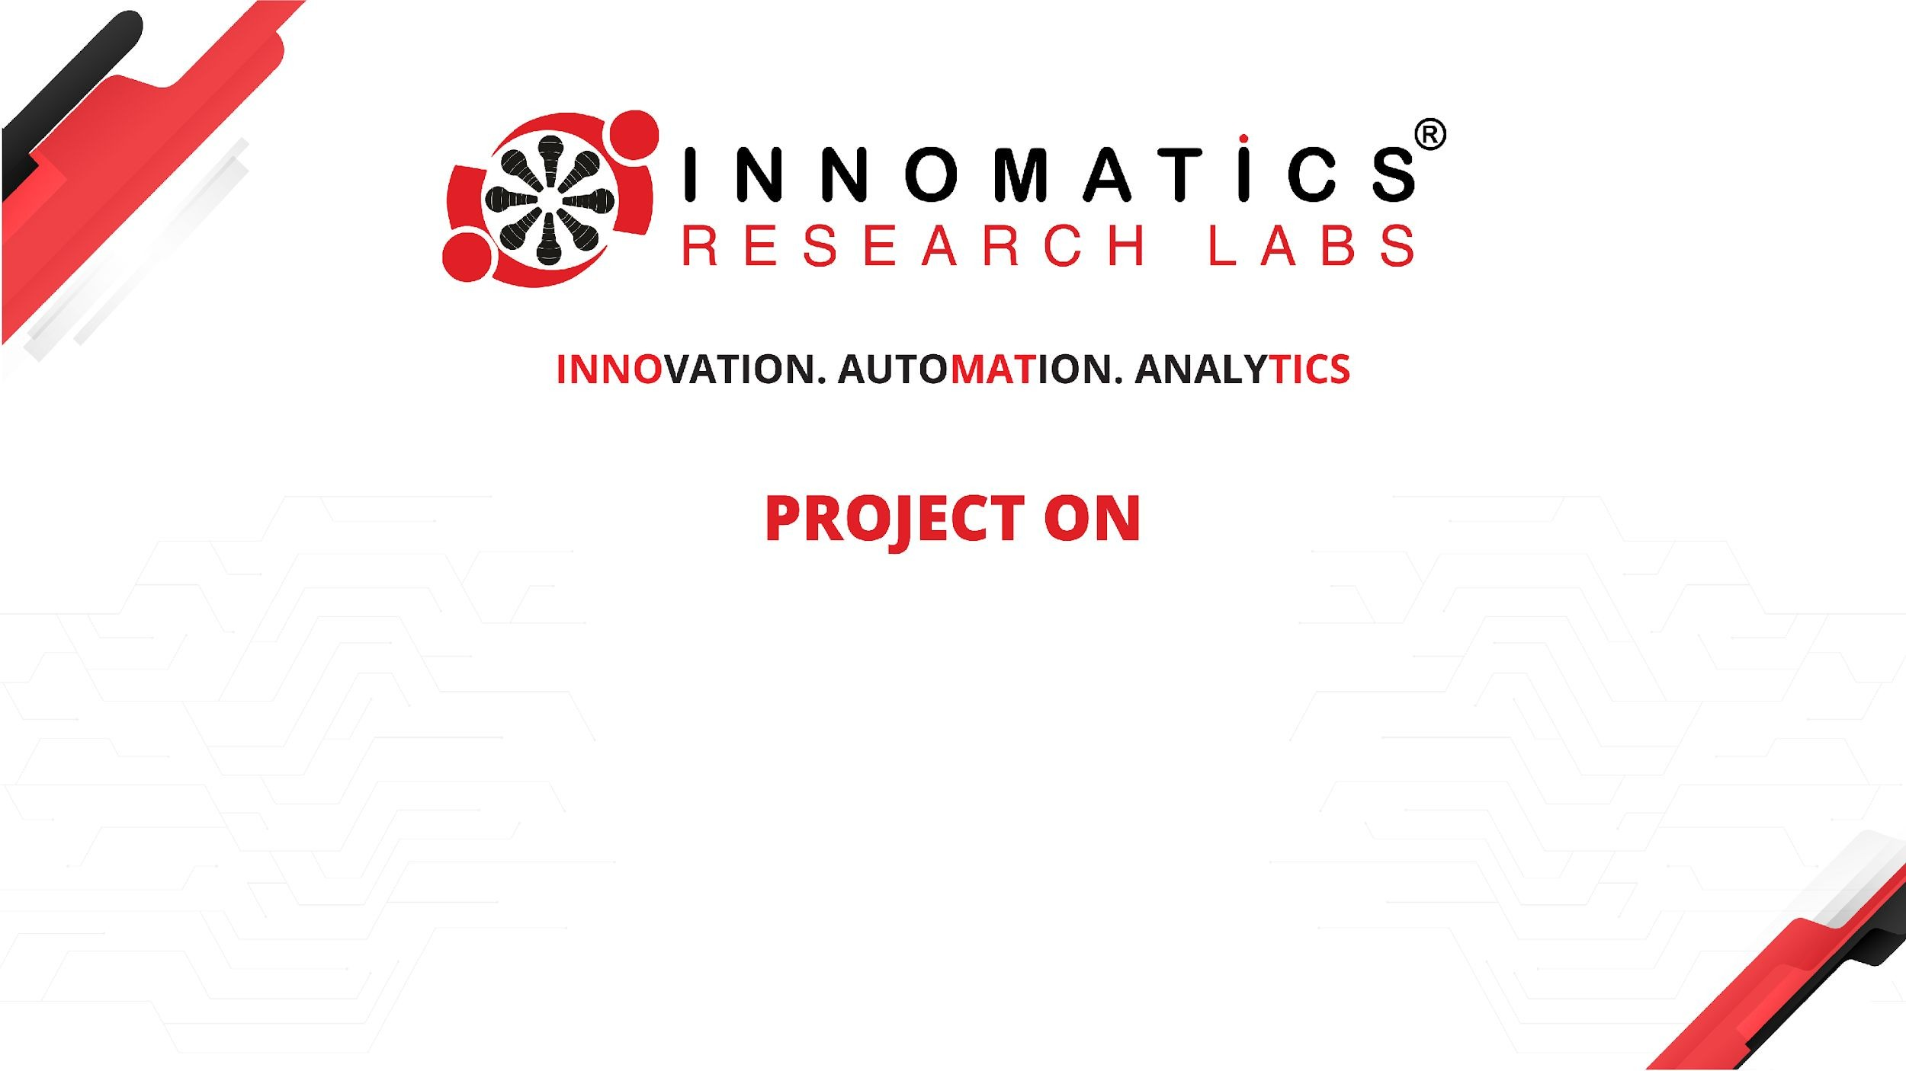
CODE REFACTORING & BUG FIXING
Shridhan Jadhav
IN1240476

Slide 2
Introduction:
A team of data scientists initiated the development of a Note Taking Application
using Python, Flask, and HTML.
Challenges arose due to the team's limited experience in backend development,
resulting in issues with the application's functionality.
Tasked with refactoring the existing codebase and ensuring seamless operation of the application.
Objective:
Fix identified bugs and issues without recreating the application from scratch.
This report documents the process of refactoring, debugging, and ensuring proper functionality of the Note Taking Application.

Slide 3
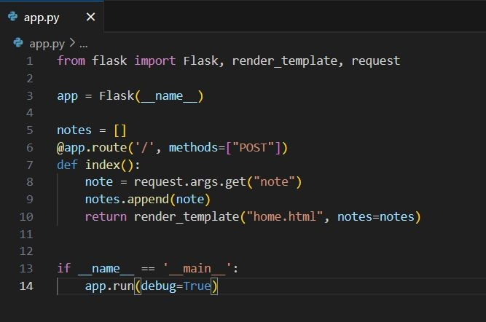
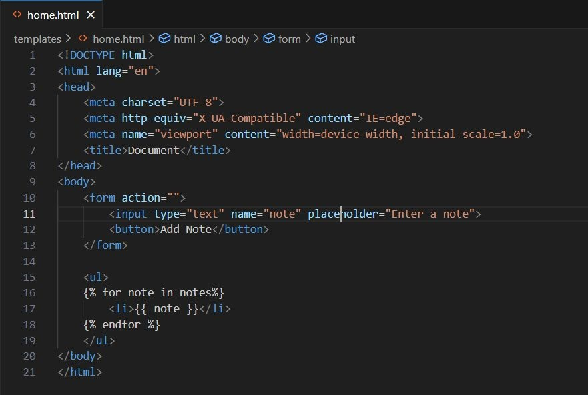
Initial Codes

Slide 4
Bug Identification
Method Not Allowed Error:
Bug Description: Users encountered a "Method Not Allowed" error when submitting notes via the form.
Resolution: Updated the Flask route to handle both GET and POST requests. Modified the HTML form to submit data using the POST method.
None Displayed after Adding Note:
Bug Description: After submitting a note, the application displayed "None" instead of the actual note.
Resolution: Changes "Button" type to submit.
Session Management:
Bug Description: Showing the data to all the user even they haven’t add the data.
Resolution: Managed the session of the user and the data added by them are visible only to them.
Additional Functionality:
User can delete all the data added by them.

Slide 5
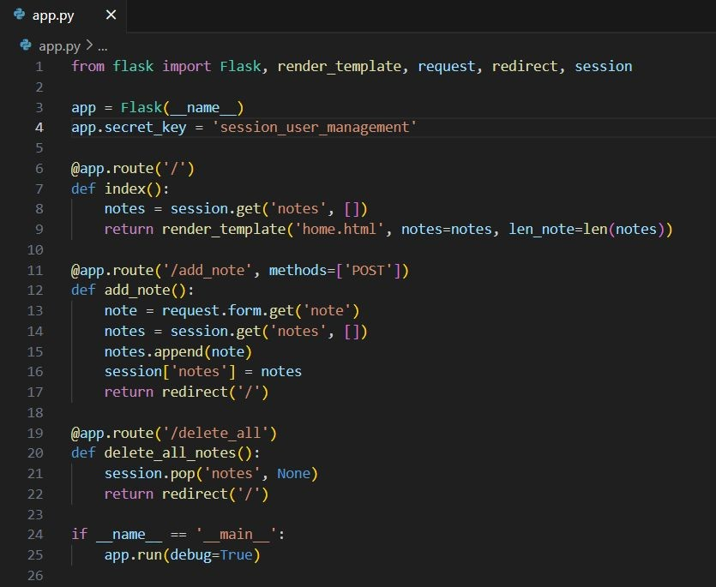
Final Codes

Slide 6
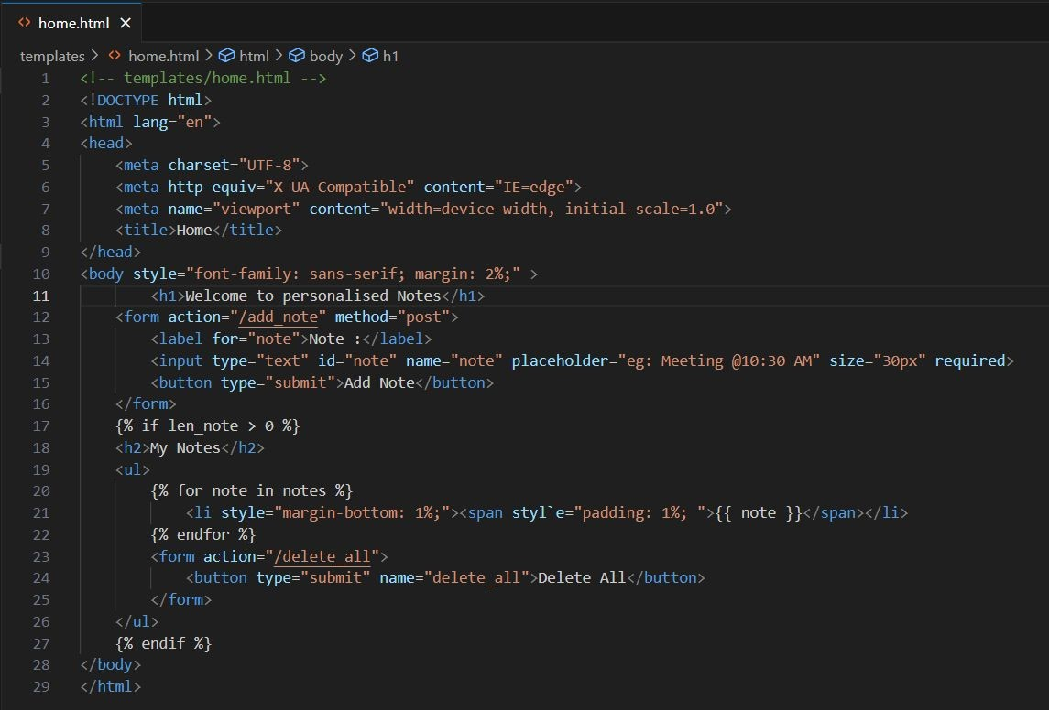

Slide 7
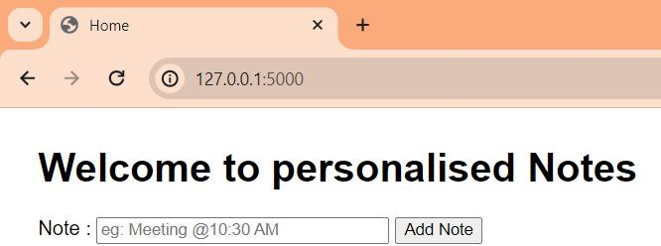
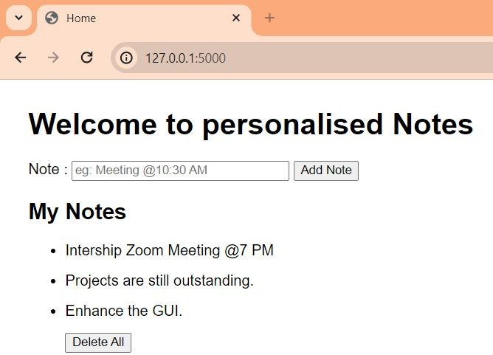
Output Snippets
Home page without any Notes
Home page with any Notes

Slide 8

THANK YOU

